Slide 1

Teaching Your Kids Programming with
Lesson 1
Notes:
This was inspired by the workshop that Ragavan had during the xTechWeek

Slide 2
About me
Ana Jalba
Associate Software Engineer
BDP – Hotels.com
Computer Science – King’s College London

Slide 3
About you
Name
Role
Why you chose to do this (short) course

Slide 4
Coming up
Why knowing how to program is important for kids
What programming is
Code examples
What it’s like to be a programmer
Introduction to Scratch
Making a flying cat

Slide 5
Why is this important?
Creativity
Confidence
Resilience / persistence
Communication and collaboration
Improve understanding of abstract concepts (like maths)
Opens up many career options
Notes:
Creativity: Kids learn through experimentation and strengthen their brains when they code, allowing them to embrace their creativity.
Confidence: solving problems
Resilience: working through challenges; instead of giving up, we debug and stick through the problem until we fix it
Collaboration: if the problem really is too hard, it’s important to ask, and with more practice, you learn when it’s time to ask someone else, and end up collaborating with other people who can teach you

Slide 6
Notes
A lot of topics may not make sense the first time around. So, refrain from negative self-thoughts
No practice = little to no improvement
Need to strike the balance of what you tell the computer to do and what you think you told it to do
It’s important to not give the whole answer away
If at any point you don’t understand something, please stop me and let me know

Slide 7
What is programming?
Source: reddit.com/r/programminghumor

Slide 8
Code examples (with popularity according to GitHub)
JavaScript (#1)
var x = 1;
if (x > 0) {
console.log("x is positive");
} else if (x == 0) {
console.log("x is 0");
} else {
console.log("x is negative");
}
Java (#3)
int x = 1;
if (x > 0) {
System.out.print("x is positive");
} else if (x == 0) {
System.out.print("x is 0");
} else {
System.out.print("x is negative");
}
Python (#2)
x = 1
if x > 0:
print("x is positive")
elif x == 0:
print("x is 0")
else:
print("x is negative")
Ruby (#4)
x = 1
if x > 0
puts "x is positive"
elsif x == 0
puts "x is 0"
else
puts "x is negative"
end
Notes:
All examples include:
Variable (a box that holds a specific value)
Conditions (something that says if

Slide 9


Variables store values
JavaScript (#1)
var x = 1;
if (x > 0) {
console.log("x is positive");
} else if (x == 0) {
console.log("x is 0");
} else {
console.log("x is negative");
}
Python (#2)
x = 1
if x > 2:
print("x is greater than 2")
elif x <= 2 and x >= 0:
print("x is 1 or 0")
else:
print("x is negative")
Java (#3)
int x = 1;
if (x > 2) {
System.out.print("x is greater than 2");
} else if (x <= 2 && x >= 0) {
System.out.print("x is 1 or 0");
} else {
System.out.print("x is negative");
}
Ruby (#4)
x = 1
if x > 2
puts "x is greater than 2"
elsif x <= 2 and x >= 0
puts "x is 1 or 0"
else
puts "x is negative"
end
Variable
1
x

Slide 10
Conditional statements say if something is true or false
JavaScript (#1)
var x = 1;
if (x > 0) {
console.log("x is positive");
} else if (x == 0) {
console.log("x is 0");
} else {
console.log("x is negative");
}
Python (#2)
x = 1
if x > 2:
print("x is greater than 2")
elif x <= 2 and x >= 0:
print("x is 1 or 0")
else:
print("x is negative")
Java (#3)
int x = 1;
if (x > 2) {
System.out.print("x is greater than 2");
} else if (x <= 2 && x >= 0) {
System.out.print("x is 1 or 0");
} else {
System.out.print("x is negative");
}
Ruby (#4)
x = 1
if x > 2
puts "x is greater than 2"
elsif x <= 2 and x >= 0
puts "x is 1 or 0"
else
puts "x is negative"
end
Conditional statement:
If a condition is met, the statement evaluates to true, otherwise, to false
Notes:
Asks a question about the state of the variable

Slide 11
Printing something
JavaScript (#1)
var x = 1;
if (x > 0) {
console.log("x is positive");
} else if (x == 0) {
console.log("x is 0");
} else {
console.log("x is negative");
}
Python (#2)
x = 1
if x > 2:
print("x is greater than 2")
elif x <= 2 and x >= 0:
print("x is 1 or 0")
else:
print("x is negative")
Java (#3)
int x = 1;
if (x > 2) {
System.out.print("x is greater than 2");
} else if (x <= 2 && x >= 0) {
System.out.print("x is 1 or 0");
} else {
System.out.print("x is negative");
}
Ruby (#4)
x = 1
if x > 2
puts "x is greater than 2"
elsif x <= 2 and x >= 0
puts "x is 1 or 0"
else
puts "x is negative"
end
Printing statement:
Tells the console/terminal to log the text “x is positive”

Slide 12
Software developers google stuff all the time
Source: reddit.com/r/programminghumor
Notes:
Programming is maybe 80% searching how to do things and 20% actually memorized code
No need to actually memorize how to write a whole program – it’s impossible

Slide 13
From xkcd comics: Wisdom of the ancients
Notes:
Researching your current issue on StackOverflow but there’s only one question posted in 2003 and there’s no answer

Slide 14
It’s not always easy
Source: reddit.com/r/programminghumor

Slide 15
But when you make it work, it’s very satisfying

Slide 16
Introduction to Scratch:
Scratch helps young people learn to:
think creatively
reason systematically
work collaboratively
Lets you program your own interactive stories, games, and animations
Notes:
You can even download it and work with it offline

Slide 17
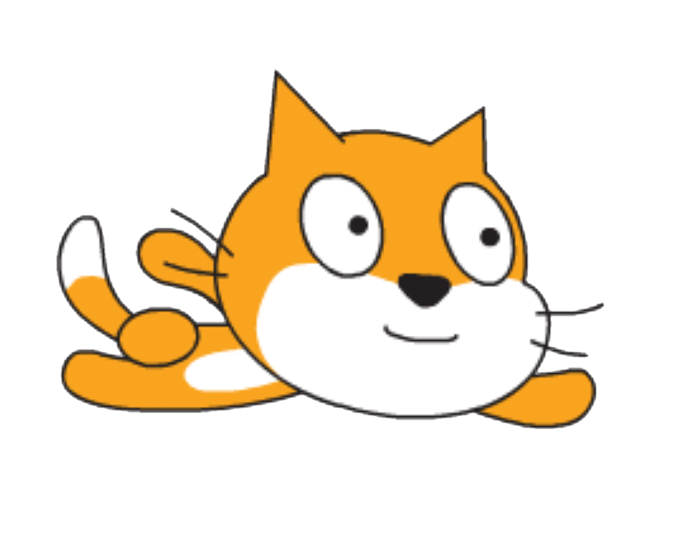
Let’s make a flying cat
By using the “Make It Fly” tutorial

Slide 18




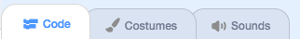
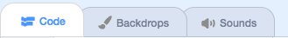
https://scratch.mit.edu
Make an account (it’s free)
click on create to start your project
Sprite = character – you can choose your own
Backdrop = background
– how to start and stop the program
– allow you to control what the sprite does (after you click on the sprite image)
– allow you to control what the backdrop does (after you click on the backdrop image)
Notes:
You can click the paintbrush to draw your own character or the folder icon to upload your own image and turn it into a character

Slide 19
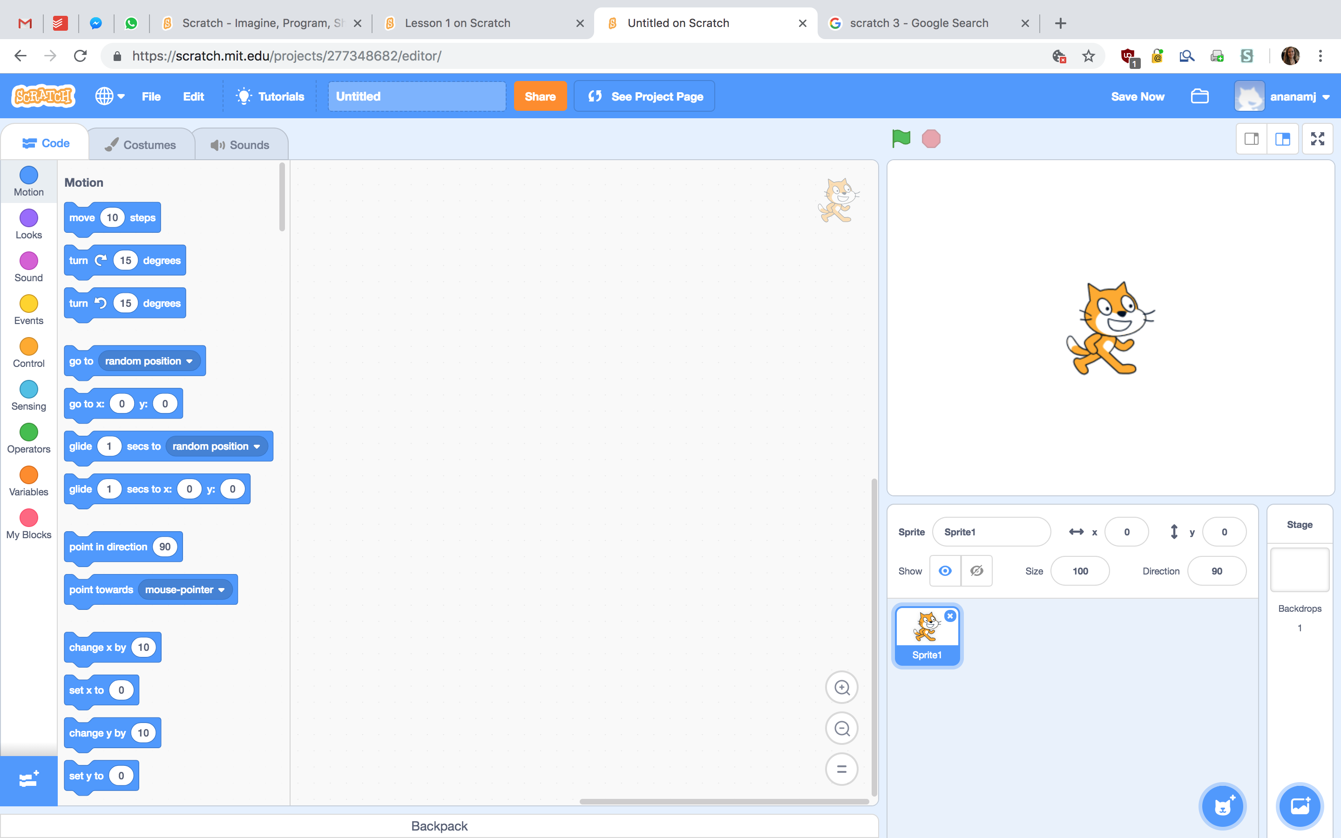
Blocks palette
Scripts area
Stage
x: -240 y: 180
x: 240 y: 180
x: -240 y: -180
x: 240 y: -180
List of sprites

Slide 20
Prepare to fly
From Events, drag to the sprite’s script area
From Looks, drag:
.
.
attach them to “when flag clicked”
It should look like this at the end

Slide 21





The scenery
Add a new sprite in the shape of a building
new sprite → buildings
Drag it to the side of the stage
Now we’re going to make it look like the cat is flying

Slide 22
Making the scenery move
Aiming for this:
From Control, drag:
.
.
From Motion, drag:
. and set it to 250 (the right end of the stage)
. and set it to -5 (moves to the left)
Make sure you are working on the building sprite
If you want to change the
costume after each loop
Notes:
x is minimum -250 and maximum 250 on the stage

Slide 23




Painting the sky
Click the icon to change the colour of the backdrop to blue
Add other thing(s) (clouds, rainbows) to the sky as a new sprite
To make the new sprite float, add a script like this to it:
If we wanted the animation of buildings and clouds to stop at the same time, what’s the number we should put for repeat?

Slide 24
Next time
Making a game in Scratch

